Slide 1

Welcome

Slide 2
Introduction
Mohammad Shekh Sadi
Assistant Teacher English,
Adamjee Cantonment Public School, Dhaka – 1206
English 2nd Paper
Class: Eight
Unit: 01 Lesson: 01
Time: 40 Minutes

Slide 3
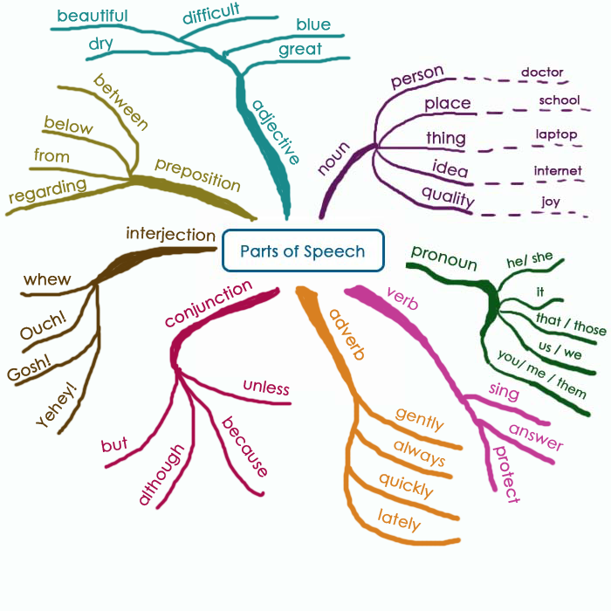

Slide 4
PARTS OF SPEECH

Slide 5
Learning outcome
By the end of the lessons the students will have able to …
a. what is parts of speech will say.
b. how many kinds of parts of speech will say.
c. mention the difference kinds of parts of speech .
d. example the difference parts of speech

Slide 6
What is Parts of speech ?
The different kinds of words which are divided according to their functions in a sentence is called parts of speech .
Examples
Sadi is a brilliant student.

Slide 7
Parts of Speech words are classified according to their functions
Noun
Interjection
Pronoun
Conjunction
Parts of speech
Adjective
Preposition
Verb
Adverb

Slide 8
What is noun ?
A noun is a word used to name something: a person, a place, a thing or an idea.
Examples
Faruq, table, water, Dhaka etc.

Slide 9
What is pronoun ?
A pronoun is a word that replaces a noun. It help us to avoid repetitions.
Noun
Pronoun
Examples
Sadi is a good boy. He goes to school regularly.

Slide 10
What is adjective ?
An adjective modifies a noun or pronoun. The adjective comes before the noun.
Examples
Noun/Pronoun
Adjective
Sadi is a good boy. He goes to school regularly.
quality

Slide 11
What is verb ?
A verb is a word which is used to indicate an action or a state of being, existence or possession etc.
verb
Examples
He goes to school regularly.
state

Slide 12
What is adverb ?
An adverb is a word that modifies a verb, an adjective or another adverb.
Adverb
Examples
He goes to school regularly.
modify

Slide 13
What is Preposition ?
Preposition are words that connect a noun or pronoun to another word in a sentence.
Preposition
Examples
He goes to school regularly.
modify

Slide 14
What is conjunction?
Conjunctions join together words, phrases and clauses.
conjunction
Examples
He is poor but his brother is rich.
adjust

Slide 15
What is interjection ?
Interjections are words used to express emotional states.
interjection
Examples
Hurrah ! We have won the game .
feeling

Slide 16
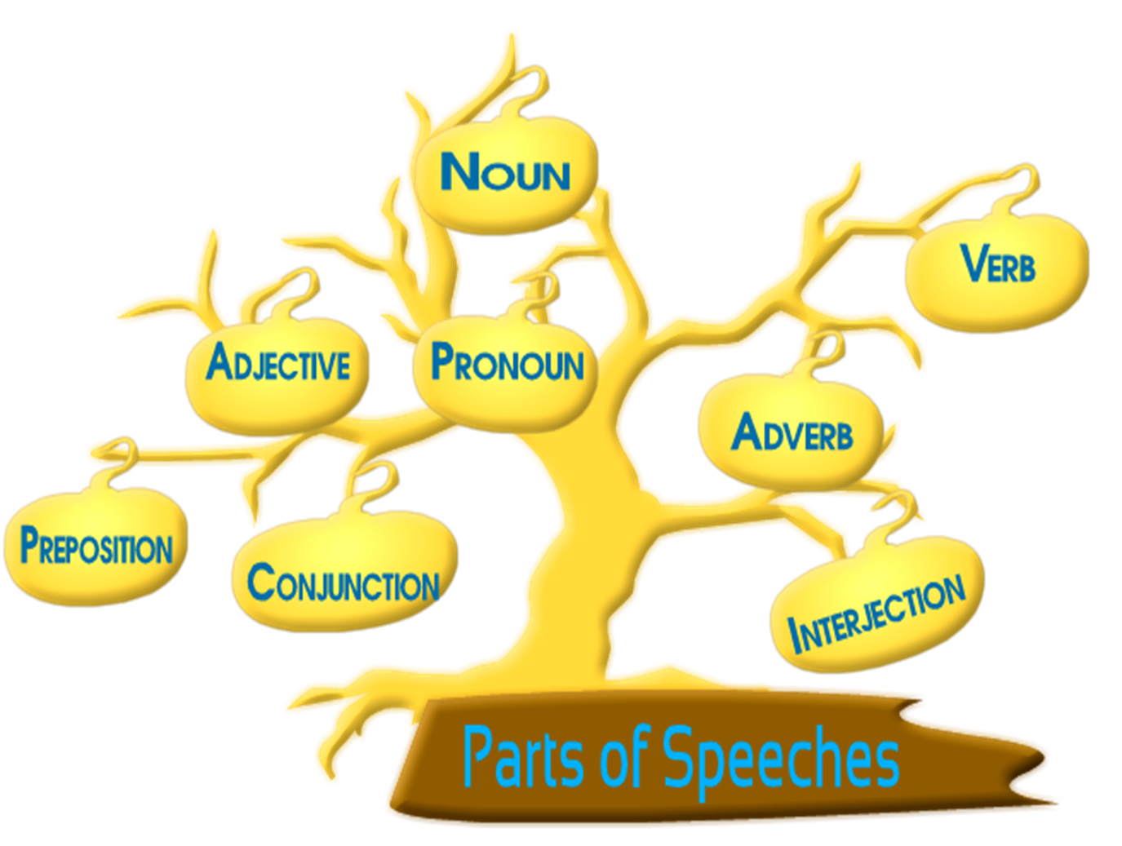
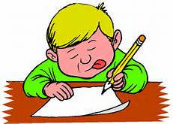
Pair Work
How many kind parts of speech ?

Slide 17


Slide 18

Group Work
With example discussion noun & pronoun

Slide 19

HOME WORK
How many kind the Parts of speech will mention it .

Slide 20

Thank You

